Slide 1

Amit Shukla Roll no-202065 CSE DEPARTMENT 2ND YR
CENTRAL UNIVERSITY OF HARYANA

Slide 2
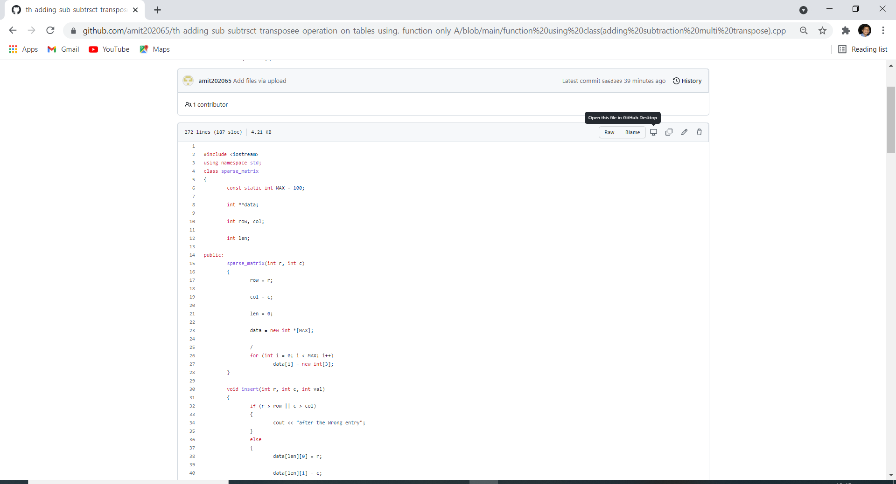

Slide 3
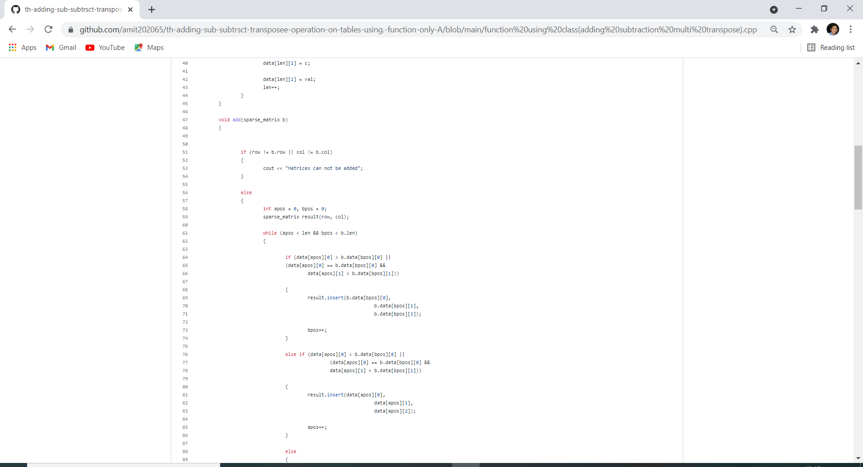

Slide 4
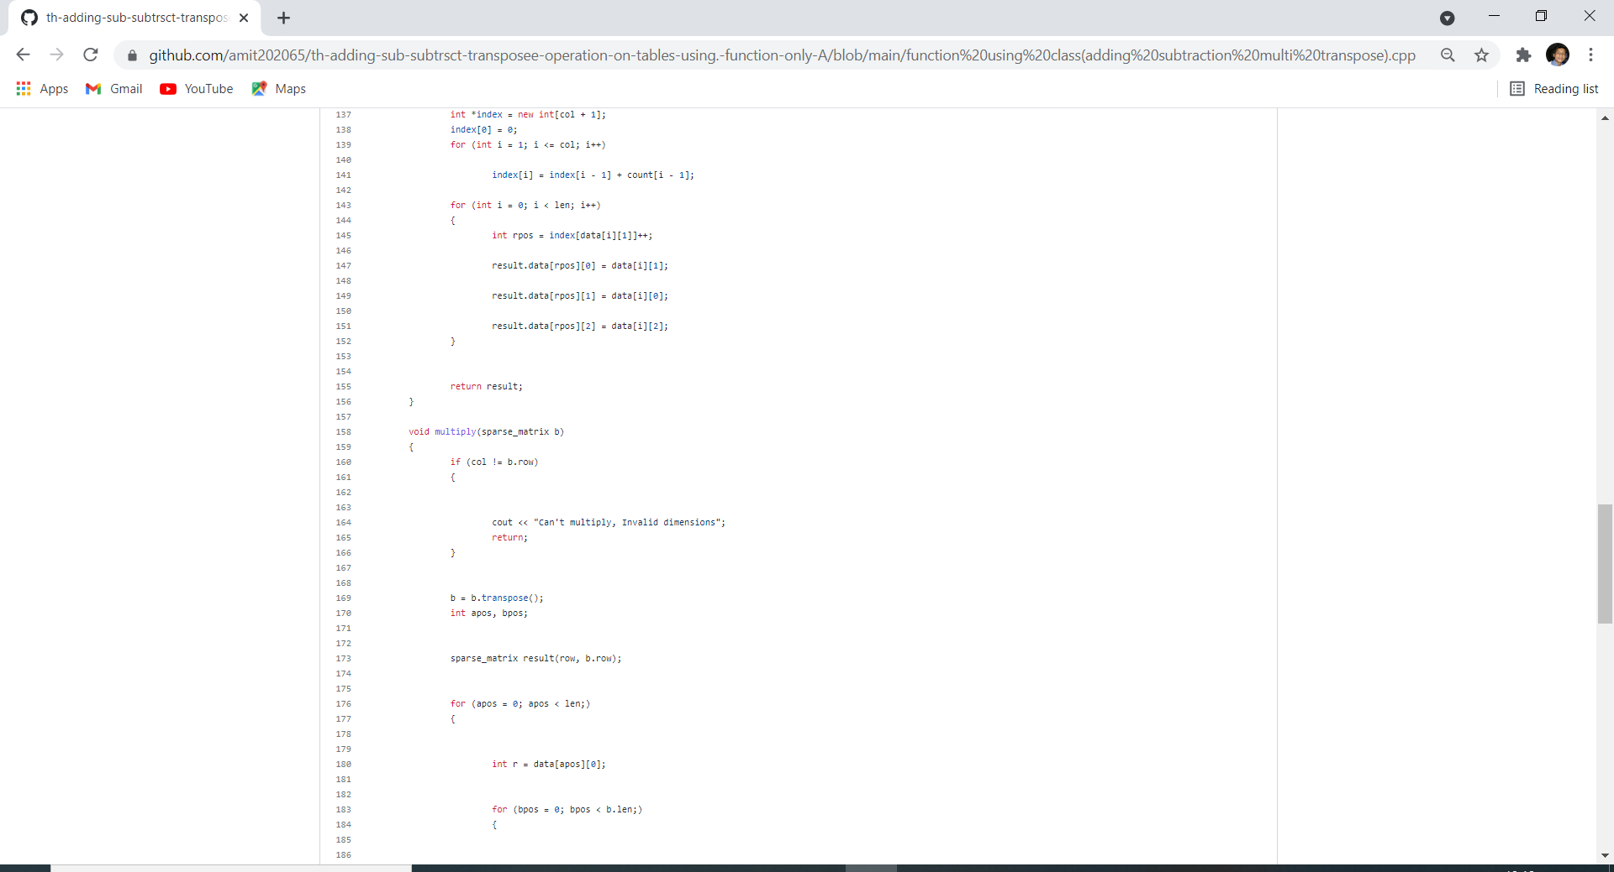
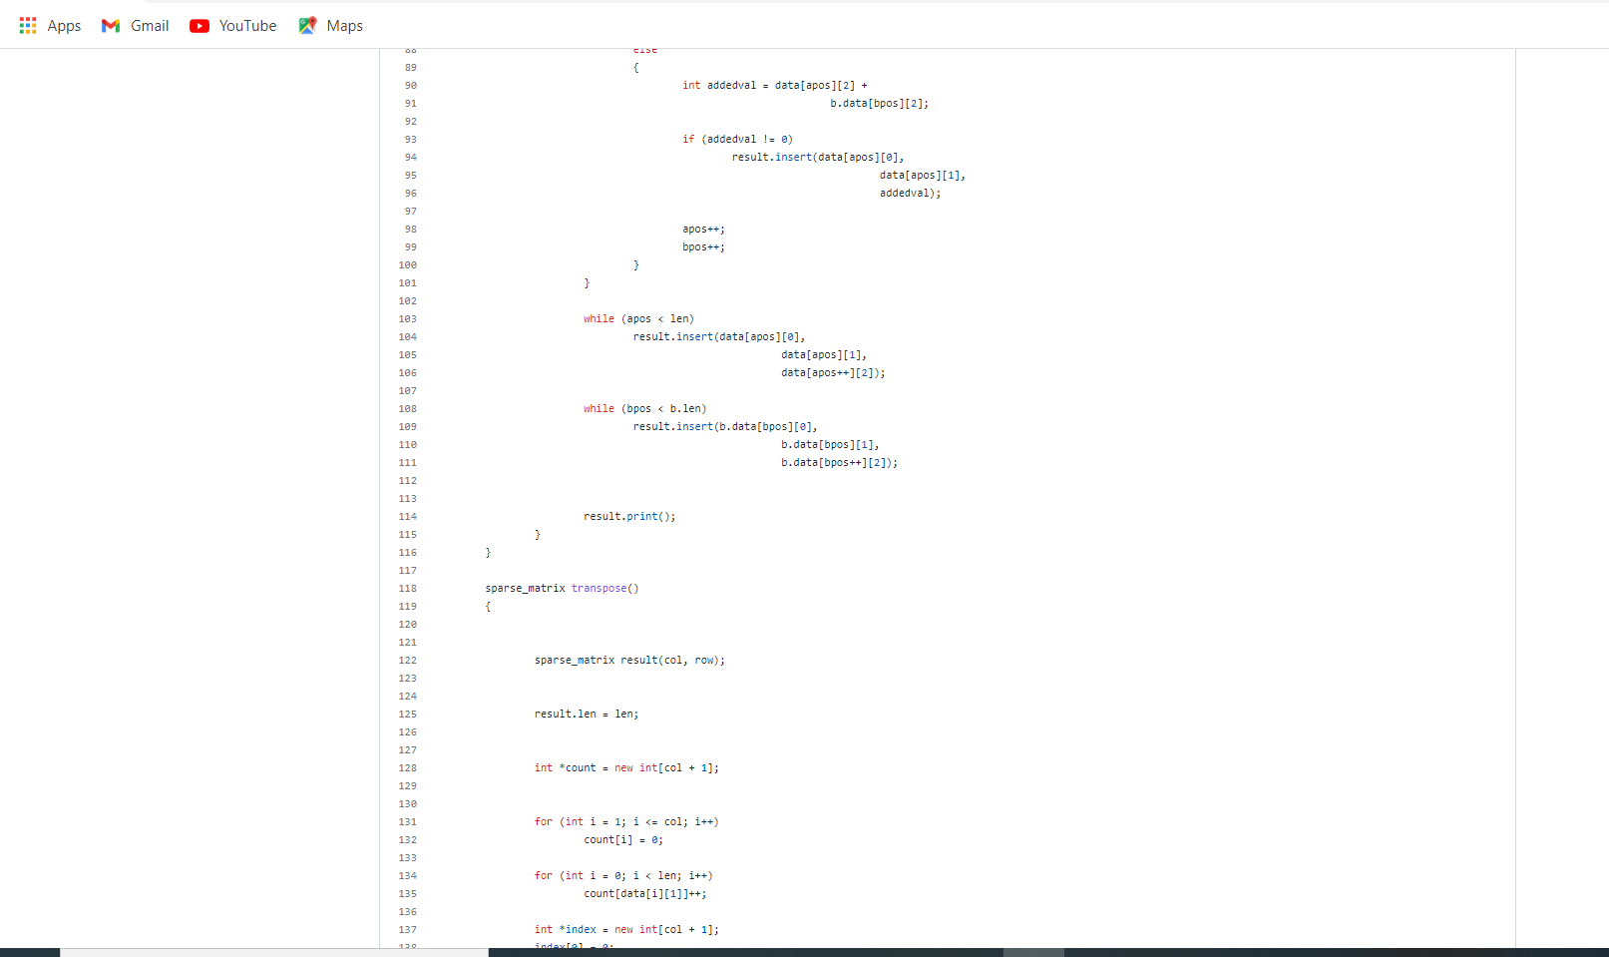

Slide 6
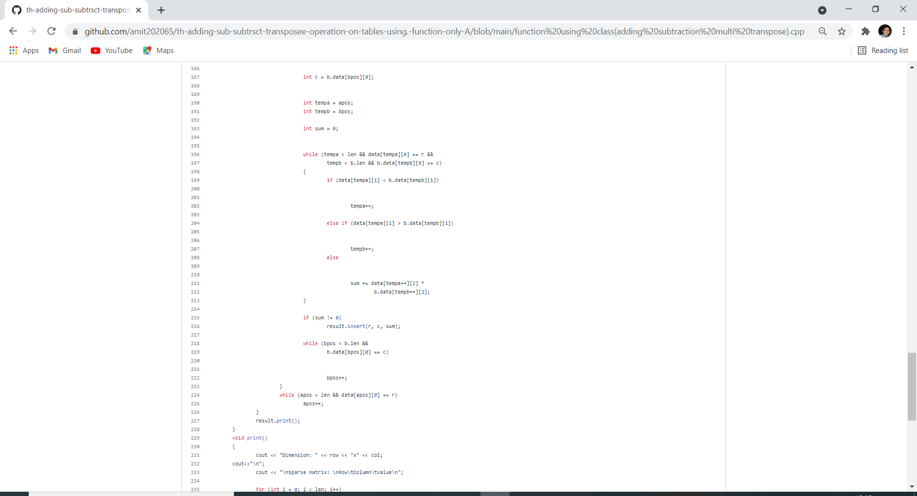

Slide 7
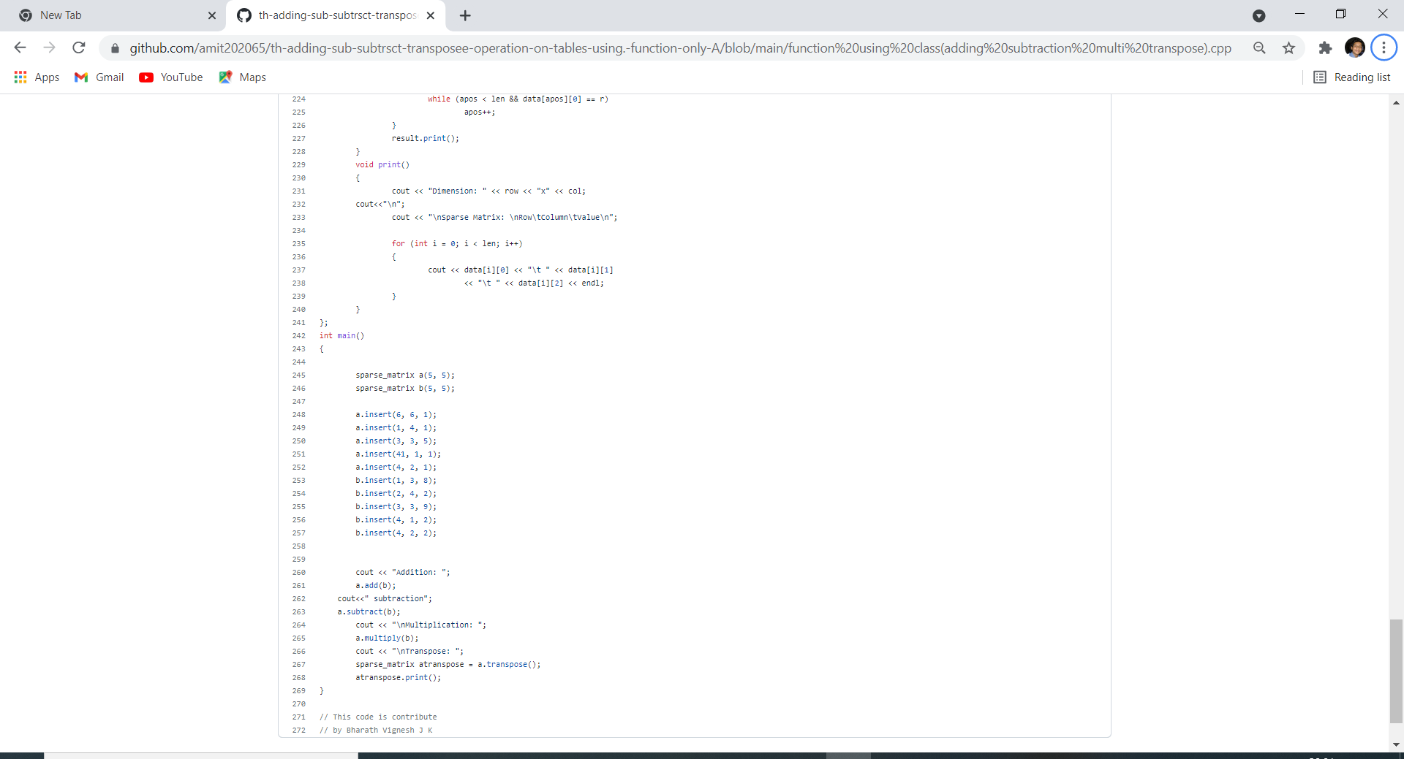

Slide 8
